Slide 1


Notes:
Good evening. My name is Mrs Bennett and together with Mrs Yarrow we thank you very much for attending this event. We won’t be keeping you too long this evening but we felt that it was imperative to share with you some strategies and advice about how to promote positive wellbeing with your children. It is our desire to have more events just like this throughout the next academic term, focusing on different topics, but I’m sure you’ll agree that an introduction to positive wellbeing was of course our top priority.
During COVID 19, so many of us struggled with the change of routine, the isolation and the threat of impending doom that was on every TV screen noon and night. While we all tried to shield our children from the anxiety that so many of us felt, it was not possible to shield them from all of it. Today in 2023, we have a new equilibrium but that doesn’t mean that there aren’t young people still struggling because of COVID and other circumstances. This means that external agencies are now struggling to cope with the ever growing demands for support from both adults and young people alike.
The promotion of positive mental health and wellbeing is more important than ever. We will be sharing with you some sobering statistics this evening, but there is also a lot of support available from us as a school and from lots of external sources.
We also are going to share with you some practical strategies that you can implement straight away to support your children’s wellbeing.

Slide 2
Support At Cardiff High school

Slide 3
Background
One in four adults and one in ten children are likely to have a mental health problem in any year (The Health and Social Care Information Centre)
Over half of all mental health problems starts by age 14 and 75% develops by age 18
Mental health services in the UK are overstretched, have long waiting times and in some regions lack specialist services

Slide 4
CHS Experiences
Pupils with a specific diagnosis
Depression
Anxiety
Exam Stress
Anger Management
School Phobia
Eating disorders
Self – harm
Suicidal ideation

Slide 5
How Can WE Help?
Promoting mental wellbeing by creating an environment where children and young people feel safe and happy
Maintaining vigilance regarding pupils’ mental health needs
Providing mental health support for pupils with particular needs
Signposting to specialist agencies

Slide 6
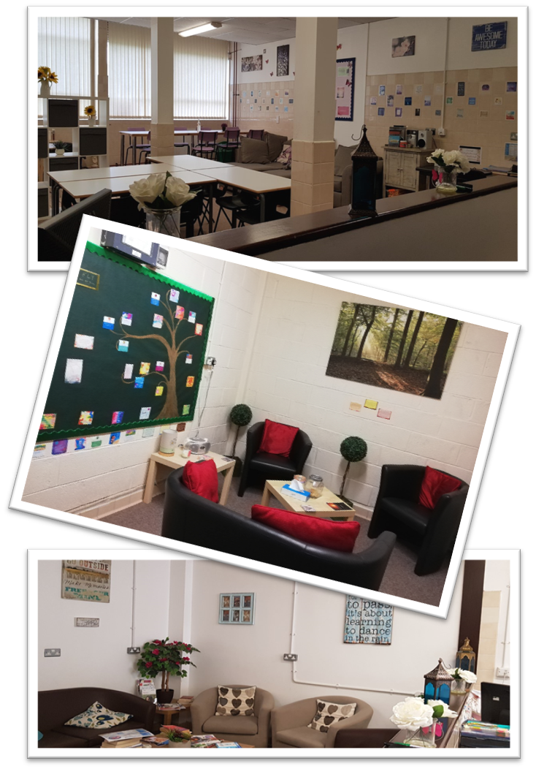
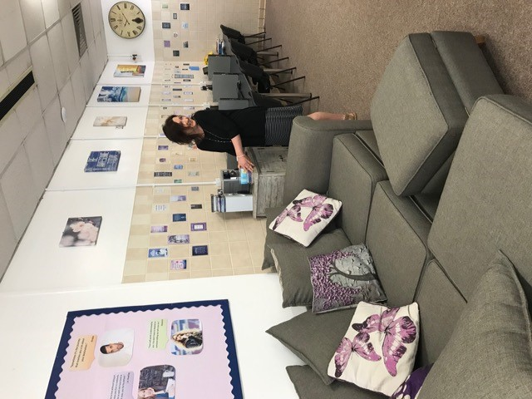
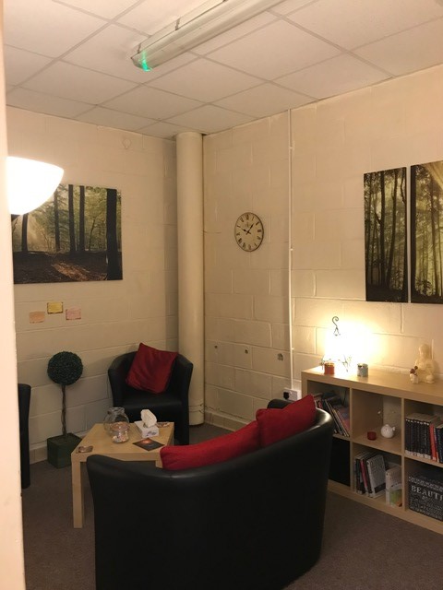
Nurture at CHS

Slide 7
Further mental health support
Local Authority Counsellor
Cardiff High School Counsellors
Educational Psychologist
Behaviour Support Specialist Teacher
Fully trained Restorative Officers
ASD Specialist and Occupational Therapist

Slide 8
Further mental health support
Animal Assisted Therapist
Relationship with CAMHS/Primary mental health team/Community Intensive Therapy Team
Nurse
Youth Mentor
Knowledge of support agencies
Communication with families

Slide 9
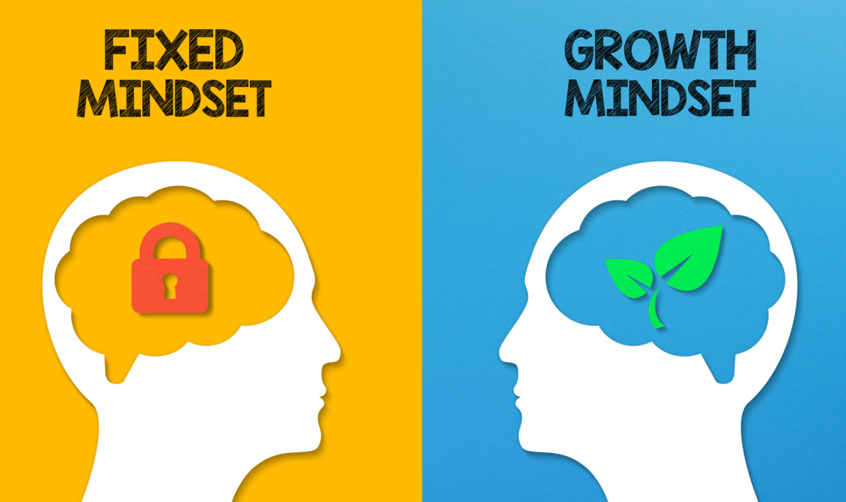
Intros
Growth Mindset
CHS Support
Social Media and Mental Health
Sleep hygiene
Q & A
Conclusion
Notes:
Carol Dweck first coined the term GROWTH mindset in 1988 and her research showed that often people who believed that intelligence was fixed also often lacked resilience when faced with new challenges and often struggled to take constructive criticism well.
Our mindset is not an innate part of who we are. We are not born with a certain mindset. This is developed through our individual experiences and interactions with others. No one has a mindset that is completely FIXED or completely capable of GROWTH. It is more about which of the above is our default setting and which is the one that we turn to in times of challenge. Also a GROWTH mindset is not the same as having high self esteem or simply a need to give yourself lots of positive affirmations.

Slide 10
Intros
Growth Mindset
CHS Support
Social Media and Mental Health
Sleep hygiene
Q & A
Conclusion
How can you help your child?
Notes:
So what can you do to help your child develop a growth mindset?

Slide 11
Intros
This is too difficult, I might as well give up.
I’m not as good at this as other people so why even try?
I’m going to avoid challenges at all costs so I don’t look stupid.
When someone gives me feedback, I take it personally.
This task is easy for me so I’ll stop pushing myself to improve so I don’t fail.
Too many other people are better than me at this so why should I even try?
I measure success by the ultimate outcome.
I already know everything there is to know.
I’m not in set 1 so I must be stupid.
You need to be in set 1.
This is difficult, but with more effort, you can improve.
You are not as good at this as other people…yet.
I enjoy taking on challenges because I learn from them and you can too.
Feedback from other people helps me learn and grow. It is not an attack on your character.
This task is easy for you but I feel like there are still ways in which you can improve.
Other people are very good at this task which means we could be too.
We measure success by the effort we’ve put into achieving the goal.
There’s so much that I don’t know yet.
Whatever class you’re in doesn’t define you; how much hard work and effort you put in is what defines the type of person you are.
Notes:
The above examples on the left can easily be reframed to make the situation an opportunity to grow and build resilience. But we have to explain as well that these small interactions have an accumulative effect. Little and often will have the impact.

Slide 12

Intros
This is too difficult, I might as well give up.
I’m not as good at this as other people so why even try?
I’m going to avoid challenges at all costs so I don’t look stupid.
When someone gives me feedback, I take it personally.
This task is easy for me so I’ll stop pushing myself to improve so I don’t fail.
Too many other people are better than me at this so why should I even try?
I measure success by the ultimate outcome.
I already know everything there is to know.
I’m not in set 1 so I must be stupid.
This is difficult, but with more effort, you can improve.
You are not as good at this as other people…yet.
I enjoy taking on challenges because I learn from them and you can too.
Feedback from other people helps me learn and grow. It is not an attack on your character.
This task is easy for you but I feel like there are still ways in which you can improve.
Other people are very good at this task which means we could be too.
We measure success by the effort we ’ve put into achieving the goal.
There’s so much that I don’t know yet and still want to learn about.
Whatever class your in doesn’t define you, how much hard work and effort is what defines the type of person you are..
Notes:
One thing that you can use this very evening is the word YET! Carol Dweck has a great TED talk on utilising the power of yet. I haven’t been able to achieve what I want… YET! You haven’t mastered that skill YET! I can’t get it… YET! Yet implies that you keep trying and that you keep exploring ways forward without giving up at the first hurdle. It focuses on progress rather than the end result, which often can seem unattainable, especially to those whose default setting is a fixed mindset.

Slide 13


School Nurse at Cardiff High School
Notes:
This year we’ve been trialling classcharts and we’ve recently shared the parental app with you. The feedback has been very positive from both you and staff as it allows us to strengthen our communication with you.
The way you as a family use Class charts is also a way you can promote positive mental health and help your child develop a growth mindset. For example, perhaps your child has achieved a merit for excellent contributions to a class discussion. You may be tempted to say, “Well done! You are so clever!” Or instead perhaps you could ask why they achieved the merit and use that as a springboard for talking about how much effort they put into that discussion (e.g. did they listen carefully to other ideas and challenge them respectively? Did they complete some independent research outside of the classroom?).
Also use praise when you see improvement in something. E.g. your child may be working hard in preparation for a test and they achieve far below the class average but have achieved more than they did in the last assessment. If they worked hard on that test then you can praise the positive and recognise the hard work they put in. EG You have learned more this time than last time. What worked well for you? How could you refine your revision technique for next time? Again this is focusing on the learning process rather than being disappointed at the end result.
Focusing on how other children fared, how they may have disappointed you or perhaps themselves will simply bring shame and it will erode the positive well being that your child has, so look for things to praise them about, but of course only give credit where credit is due!
Now on the topic of APPS I’m going to hand over to Mrs Yarrow who has some information about social media and wellbeing.

Slide 14

Social Media
And its impact on young people

Slide 15

The internet is a fantastic tool and an ever increasing part of our daily lives
Using search engines
Sharing images and watching videos
Using forums and social networking sites
Playing games (alone and/or with others)
Chatting to others on line
Young people are likely to experience/participate in:

Slide 16
Statistics
83% of teens aged 12 – 15 have mobiles, over 70% have smart phones
8 -18 year olds devote an average of 7 hours and 38 minutes to using social media across a typical day
A typical teen sends and receives an average of at least 30 messages per day
50% have seen sexual, violent and other adult material on social media sites, apps and games
78% reported that they had joined social media sites before reaching the specified minimum age
Recent study of just under 7000 adolescents found that those who spent more than three hours a day on social media had twice the risk of symptoms of depression and anxiety as non users
The studies also found that reducing social media use led to improvements in mental health

Slide 17
Recent Study by Royal Society of Public Health on Social Media #StatusofMind
… social media use has been described as being more addictive that cigarettes and alcohol
The study ranks the main 5 social media platforms in terms of their positive and negative impact on young people’s health and wellbeing with YouTube ranking the most positive and Instagram the most negative – the main factor for Instagram being the negative impact on body image
Nurtures a fear of missing out
Peer pressure

Slide 18
Recent Study by Royal Society of Public Health on Social Media #StatusofMind
Social media can become a life comparison tool - constantly comparing to others
Potentially leading to low self esteem, increased anxiety and depression
Negative impact on eye sight
Negative impact on sleep – due to the blue light emitted from devices which delay the release of sleep inducing melatonin

Slide 19
Dangers of Social media
Studies also suggests that while frequent use of social media does appear to be linked to poorer mental health, the effects are not necessarily direct. Instead, they suggest that such links might be down to social media use displacing other activities such as sleep and exercise.

Slide 20

Negative Impact – A School Perspective…

Slide 21
Issues Within School
Sexting
Cyberbyllying

Slide 22
Issues Within School
Sexting

Slide 23
Sexting – also known as ‘trading nudes’, ‘dirties’ and
‘pic for pic’
The sharing of inappropriate or explicit images on line
Sending pictures and inappropriate content has almost become normal teenage behaviour. It is seen as flirting by some children and teenagers who feel that it is part of normal life.
Leaves people vulnerable to bullying and harm
No control over the sharing of images
The dangers
Can have long term harmful effects
It’s illegal
http://www.nspcc.org.uk/preventing-abuse/keeping-children-safe/sexting/
Notes:
No control
It's easy to send a photo or message but the sender has no control about how it's passed on.
When images are stored or shared online they become public. They can be deleted on social media or may only last a few seconds on apps like Snapchat, but images can still be saved or copied by others.
These images may never be completely removed and could be found in the future, for example when applying for jobs or university.
Harmful effects
Young people may see 'sexting' as harmless activity but there are risks. Taking, sharing or receiving an image, even voluntarily, can have a long-lasting negative impact. – discuss the emotional impact and possible impact on career etc
Illegal
It may be common but 'sexting' is illegal. By sending an explicit image, a young person is producing and distributing child abuse images and risks being prosecuted, even if the picture is taken and shared with their permission
Vulnerable to bullying etc:
Blackmail
An offender may threaten to share the pictures with the child's family and friends unless the child sends money or more images.
Bullying
If images are shared with their peers or in school, the child may bebullied.
Unwanted attention
Images posted online can attract the attention of sex offenders, who know how to search for, collect and modify images.
Emotional distress
Children can feel embarrassed and humiliated. If they are very distressed this could lead to suicide or self-harm.

Slide 24
Sexting – Four steps to trouble
1: Sarah, 14, takes a sexual photo of herself on her camera-phone and sends it to her boyfriend James, 15.
Sarah is now potentially guilty of distributing child pornography. James is potentially guilty of possession of child pornography
2: Sarah dumps James. Out of revenge James sends the photo to his friends at school.
James is now guilty of distributing - and his friends of possession - of child pornography. Sarah is embarrassed as a sexual photo of herself circulates school
3: James’s friend uploads the photo to a social networking profile, where his photos are visible to the public.
James is in breach of website terms and guilty of distributing child pornography
4: Paedophiles browse profiles with loose privacy settings and find the image of Sarah.
Sarah unwittingly becomes the subject of child pornography for distribution among strangers and paedophiles
Notes:
Go through and ask for feedback at each stage.
Give out the Daily Telegraph article for further reading

Slide 25
Issues Within School
Cyberbullying

Slide 26




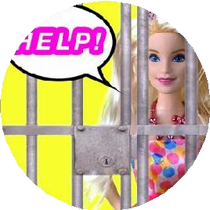





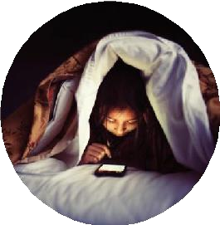


Why is cyberbullying different?
Hard to escape
Instantly reaches audience
Repetitive
Hard to police
24hour access
Anonymity

Slide 27





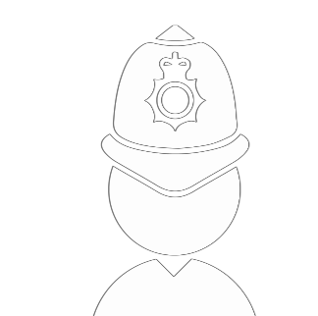

The do’s
!
Block
Report
Keep the evidence
Know when to take it further

Slide 28

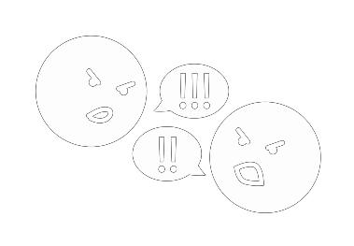



The don’ts
Retaliate
Stop them going online
Deal with it alone
Stop when the bullying stops

Slide 29
Sites To Be Aware of….

Slide 30
Top 5 Sites Where Young People Reported Seeing Inappropriate Content
Sickipedia (100% of children surveyed)
Chatroulette (92%)
Omegle (89%)
Ask.fm (88%)
Yik Yak (74%)

Slide 31
What Can You Do?
What to talk about
Ask your children to tell you about the sites they like to visit and what they enjoy doing online
Encourage them to help you. Perhaps they can show you how to do something better online
Ask them about how they stay safe online. What tips do they have for you, and where did they learn them? What is OK and not OK to share?
Ask them if they know where to go for help, where to find the safety advice, privacy settings and how to report or block on the services they use

Slide 32
What Can You Do?
What to talk about
They can come to you if they see anything that upsets them
If they have seen pornography…that it presents an unrealistic image of sex and relationships
Sometimes people hide behind fake profiles for dishonest reasons -Never meet up with anyone they don’t know in real life
Agree how they will respond to requests from people they don’t know in real life
Think about how you use the internet as a family. What could you do to get more out of the internet together and further enjoy your lives online?

Slide 33

Controlling tech time
There are tactics you can put in place to help manage their screen time….
Set a good example
Get the whole family to unplug & create screen free zones
Talk together about the time spent online
Agree on appropriate length of time they can use their device
Use technology / apps to help manage screen time and to monitor activity

Slide 34
Apps To Protect Your Child
Qustodio Parental Control App
Net Nanny
Norton Family
mSpy
Bark – Parental Controls
Mobicip
FamiSafe – Location Tracker
Screen Time – Parental Control
Family Time Parental Control

Slide 35
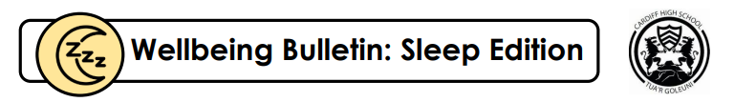
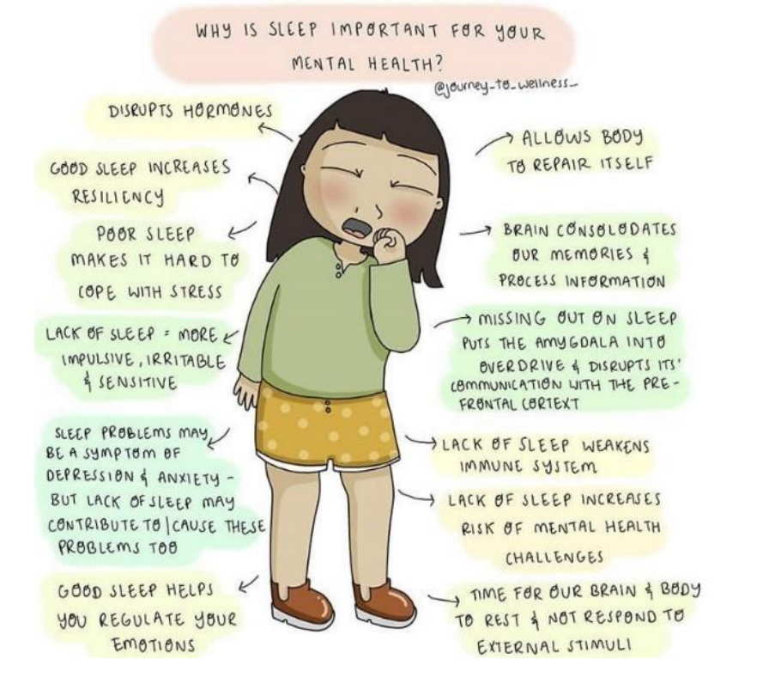
School Nurse at Cardiff High School
Sleep Hygiene
Sleep is important for the following reasons:
Our body repairs itself during sleep.
We problem solve more easily if well rested.
Further issues can be linked to a lack of a sleep, such as depression or anxiety.
Our immune system is disrupted, too leaving our physical body at greater risk of becoming ill more often.
We cope better with challenging situations if we have plenty of sleep.
Notes:
Having good sleep hygiene or a solid sleep routine is incredibly important for people of all ages. A lack of healthy sleep hygiene can be one of the biggest contributors to poor mental health that we see in young people in school. We as the Achievement Team often hear from you and your children about children being constantly glued to their phones and staying up late watching some television in bed or using social media throughout the night. This can be incredibly disruptive to the brain and consequently the rest of the body. Quickly it becomes a vicious cycle of being overstimulated, which means your child is unable to drop off to sleep as easily as they should and then they repeat the pattern the next night and so on.

Slide 36
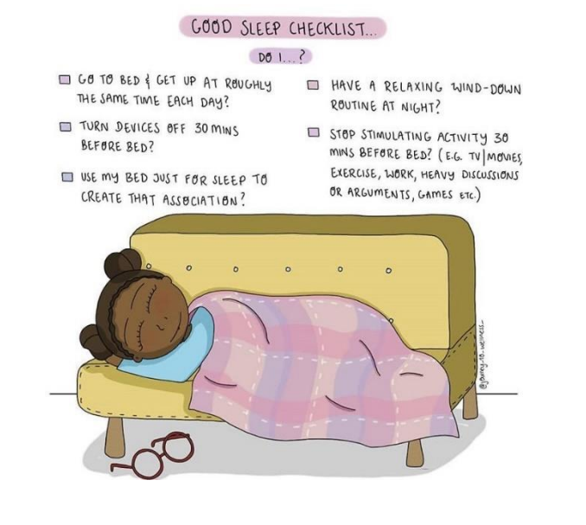







School Nurse at Cardiff High School
Sleep Hygiene
Having issues with your sleep? Try these:
Notes:
Think about how you as a family can help encourage a better level of sleep hygiene.
Setting your schedule: Establishing a routine makes it easier for your mind and body to get used to a consistent sleep schedule. I’m sure lots of your children had very good sleep schedules when they were much younger. It helps at this age too!
.See the Light: Exposure to light plays a crucial role in helping our bodies regulate sleep in a healthy way. If you can, spend some time outside in natural light. Even if the sun isn’t shining brightly, natural light still has positive effects on circadian rhythm.
Stay Active: Regular daily activity has numerous important benefits, including helping people with their sleep hygiene.
.Be Kind to Yourself: It might not seem critical to your sleep, but self-care can reduce stress and its harmful effects on mood and sleep. While certain situations can feel overwhelming, try to find time for yourself and your child where you both can just do something positive for yourselves.
Relaxation: Finding ways to relax can be a potent tool to improve your sleep. Deep breathing, stretching, yoga, mindfulness meditation, calming music, and quiet reading are just a few examples of relaxation techniques that you can build into your routines.
Watch What You Eat and Drink: Keeping a healthy diet can promote good sleep. Also be cautious with the intake of caffeine, as this can disrupt your sleep. While your child may not drink coffee remember things like chocolate or chewing gum products can contain caffeine in their recipes.
.Screen Time: The blue light produced by mobile phones, tablets, and computers, has been found to interfere with the body’s natural sleep-promoting processes. Avoid using these devices for at least an hour before bed and cut down the total time that your child spends scrolling on social media.

Slide 37
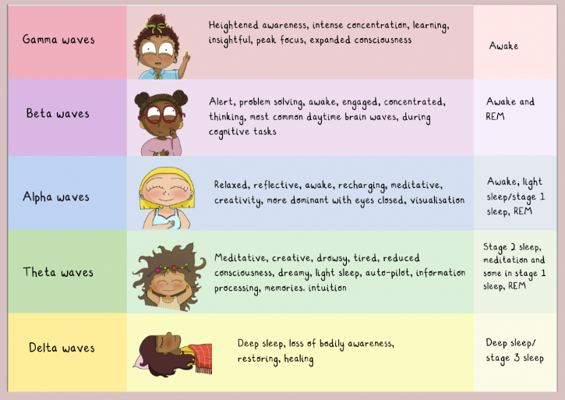
School Nurse at Cardiff High School
Sleep Hygiene
Your morning routine is also very important!
Waking up and reaching for your phone alters the natural pattern of your brain waves, skipping over theta and alpha states.
Disruption of this pattern can increase the likelihood of feeling anxious or becoming hyper-vigilant.
Notes:
We’ve heard about how mobile phones and other devices can emit blue light which can delay people falling asleep at night. But phones can also play a part in how we face each day. Waking up and reaching for your phone immediately alters the natural pattern of your brain waves, skipping over theta and alpha states. This pushes our brains into overdrive and this disruption of the brainwave pattern can increase the likelihood of feeling anxious or becoming hyper-vigilant – in a state of alarm all day.

Slide 38

School Nurse at Cardiff High School
Sleep Hygiene
Your morning routine is also very important!
Waking up and reaching for your phone alters the natural pattern of your brain waves, skipping over theta and alpha states.
Disruption of this pattern can increase the likelihood of feeling anxious or becoming hyper-vigilant.
Notes:
Simply put, mobile phones should remain out of the bedroom. Old fashioned alarm clocks will be do the job of waking you up and could also really help your child in the long run. Also it prevents them from being bombarded by messages from cyber bullies and becoming distressed throughout the night.

Slide 39


Advice on how to talk about mental health from
Complete an activity together to help make the talk less formal.
Some ideas include:
Take a walk
Go for a drive
Ready, set… BAKE
Create something together (a jigsaw, etc)
Have a kickabout
Share your music
Use some adult colouring in books
Yoga
Notes:
Thankfully there is less stigma about mental health and mental wellbeing, but we recognise this is still a daunting task for lots us. So Young Minds have created some amazing resources for parents, young people and professionals. WE highly recommend you visit their website. Here they give us some insights into how to begin a conversation about this topic. The activity doesn’t really matter, but what does matter is that you are able to spend some quality time together and then you can broach the topic of their mental health. Having something to do with their hands, or something practical to focus on, can also make it easier for some children and young people to reflect or think more clearly.
Rather than feeling like a ‘big chat’, the conversation can start more naturally.

Slide 40
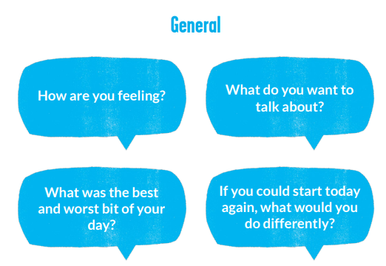
Conservations prompts like things can be really useful to start off a discussion.

Slide 41
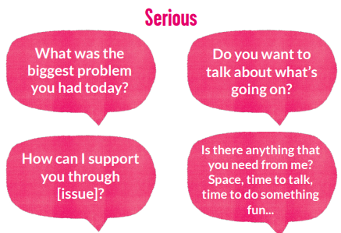
Using more direct language can help your child open up when used at the right time.
Notes:
The direct route can also help your child. They may feel not be able to independently articulate what they need when struggling. So questions like the examples here can be really helpful to break the issue into smaller more manageable chunks for them.

Slide 42
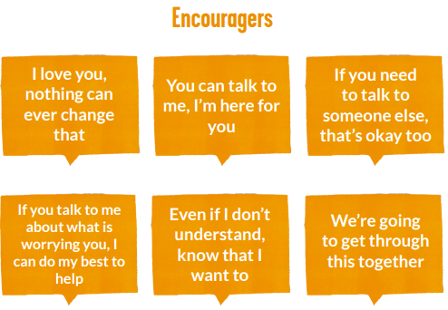
These prompts let your child know that you are still here for them.
Notes:
But you’re the leading expert when it comes to your child. You can tell when they aren’t in the mood to talk, or when they aren’t responding to your attempts. Perhaps they aren’t ready but at least you’ve given them the opportunity and they will more likely come to you knowing that you are receptive to having a conversation about what’s going on.
Reassure them that if they don’t want to talk now, they can talk to you at any time. You can also use these encouragers to leave the door open for further talks when they are ready.
If you are concerned about anything that has come up in a conversation, try your best to tell them how you see things, and be clear about any actions you are going to take. Try to provide comfort and reassurance.
Importantly, try to adopt a very neutral face. If you let your worry or fear show on your face, especially if they have opened up to you, then it could give them the signal that they’ve upset you or they’ve done something wrong.

Slide 43


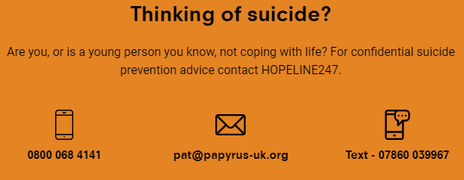
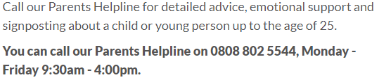
What to do next?
Notes:
Knowledge is power so Young Minds and Papyrus are two fantastic charities that can offer support and advice on how best to support your child.
They have a variety of ways to contact them, for example, email and webchat is also available but you can just pick up the phone as well.
Papyrus is a charity working towards preventing young suicide, but they also have fantastic resources to support young people and their families / carers for other issues too.

Slide 44
How can Cardiff High help?
You can email your child’s Achievement Leader or Head of School.
You can email either myself or Mrs Yarrow.
  yarrowA@hwbcymru.net
  bennettm15@hwbcymru.net
3) You can telephone the school and leave a message for our Achievement Team if you are not sure who to contact.
Notes:
You can email your child’s Achievement Leader or Head of School.
You can email either myself or Mrs Yarrow.
yarrowA@hwbcymru.net
bennettm15@hwbcymru.net
3) You can telephone the school and leave a message for our Achievement Team if you are not sure who to contact.
We will check in with your child and signpost you as a family to the appropriate service for support. If your child were to access the schoolbased services Mrs Yarrow discussed earlier then those would take place most likely during a lesson and please be reassured that if your child needs support it is best we prioritise that over them remaining in class and the situation getting worse. Lots of appointments are fortnightly and we also try not to hit the same lesson every time as well.

Slide 45
Notes:
Please feel free to stay behind and speak to us if you have specific concerns about your child or contact us via telephone and email if that is more suitable. These slides will be shared with you via our school website and a link will be shared via parentpay too.
Thank you very much for your time this evening. This event was about raising awareness of how we as a school can help and it has allowed us to share some practical strategies that can support you as a family. Parenting is the toughest job in the world and we hope that you walk away from this evening feeling empowered about how to tackle any struggles your child is going through now or could potentially go through in the future.
Thanks again and take care all.

