Slide 1
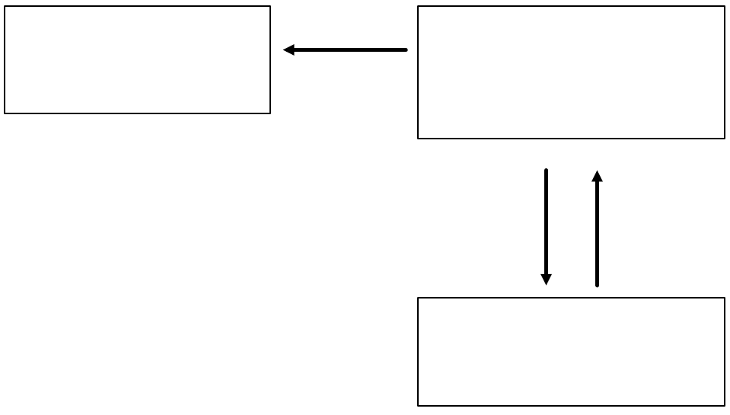
Do Now
Individually and silently…
… see if you can remember the parts of the ‘How we Learn’ model that was introduced to you during your induction day.

Slide 2
Classroom
specific focus
Working Memory
“where we think”
small and easily overloaded
Attention
Learning
Remembering
Long Term Memory
infinite
Forgetting

Slide 3
Active participation in lessons
Effective use of time in between lessons
Success
+
=

Slide 4
Classroom
specific focus
Working Memory
“where we think”
small and easily overloaded
Attention
Learning
Remembering
Long Term Memory
infinite
Forgetting

Slide 5
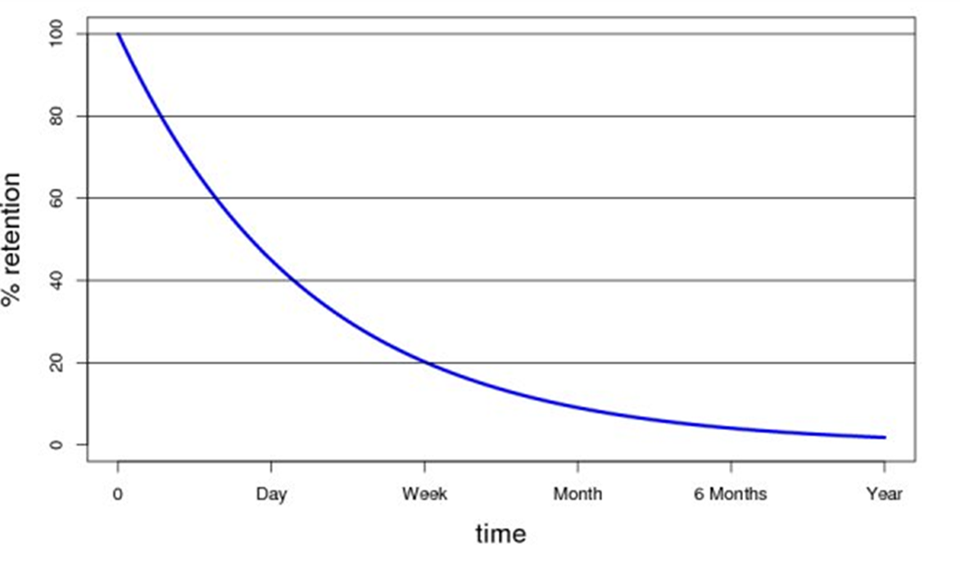

Slide 6
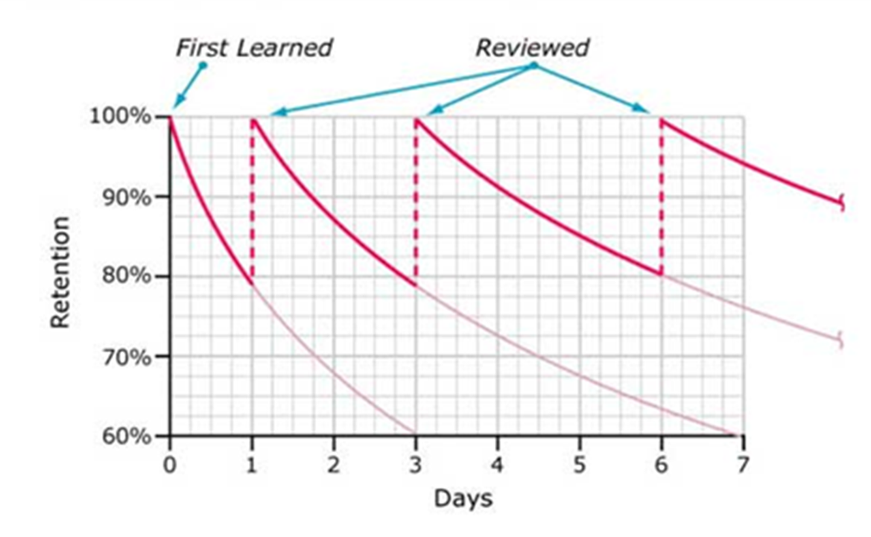

Slide 7
“Every time a memory is retrieved, that memory become more accessible in the future.”

Slide 8
So how can you help yourself?
Planned retrieval
Effective activities
Time management

Slide 9
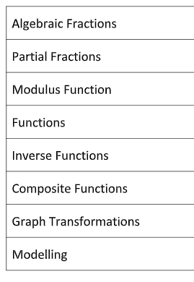
Planned Retrieval
Specific Topics
Revision doesn’t wait until the end

Slide 10


Effective Activities
DON’T re-read notes / highlight / copy
These activities do not make you think
DO mind maps / self test / past paper questions / HOMEWORK

Slide 11
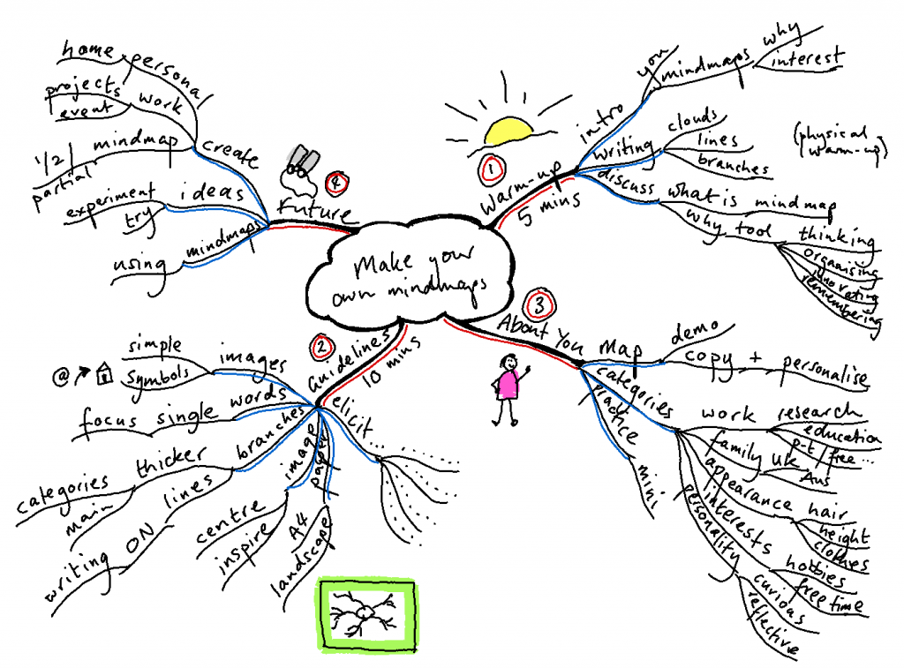

Slide 12


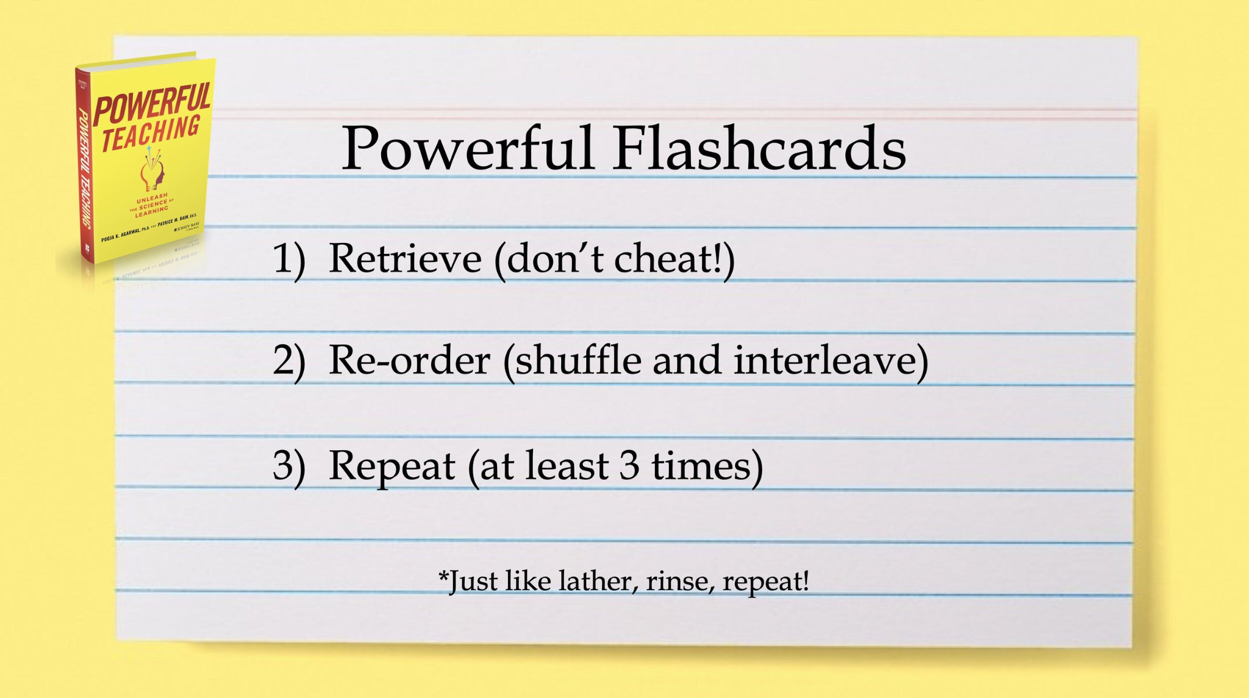

Slide 13


Subject specific
Individual Classes - Homework

Slide 14
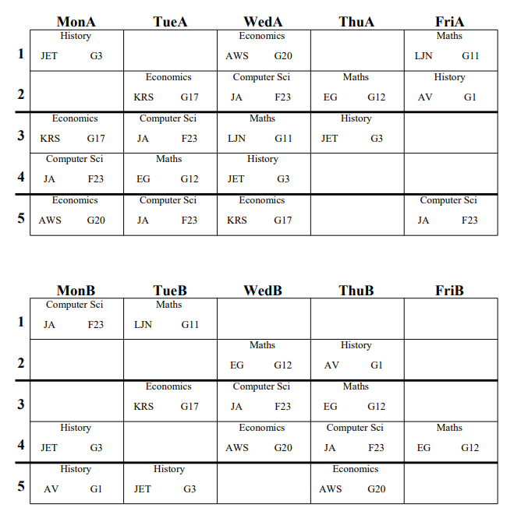
Time Management
Econ
Maths
History
Comp.
History
Comp.
Don’t waste time in school
gym
Maths
History
Econ.
Comp.
Maths
Econ.
History
Maths
Econ.
Catch up
football

Slide 15
So how can you help yourself?
Planned retrieval
Effective activities
Time management

Slide 16
Active participation in lessons
Effective use of time in between lessons
Success
+
=

